Slide 1
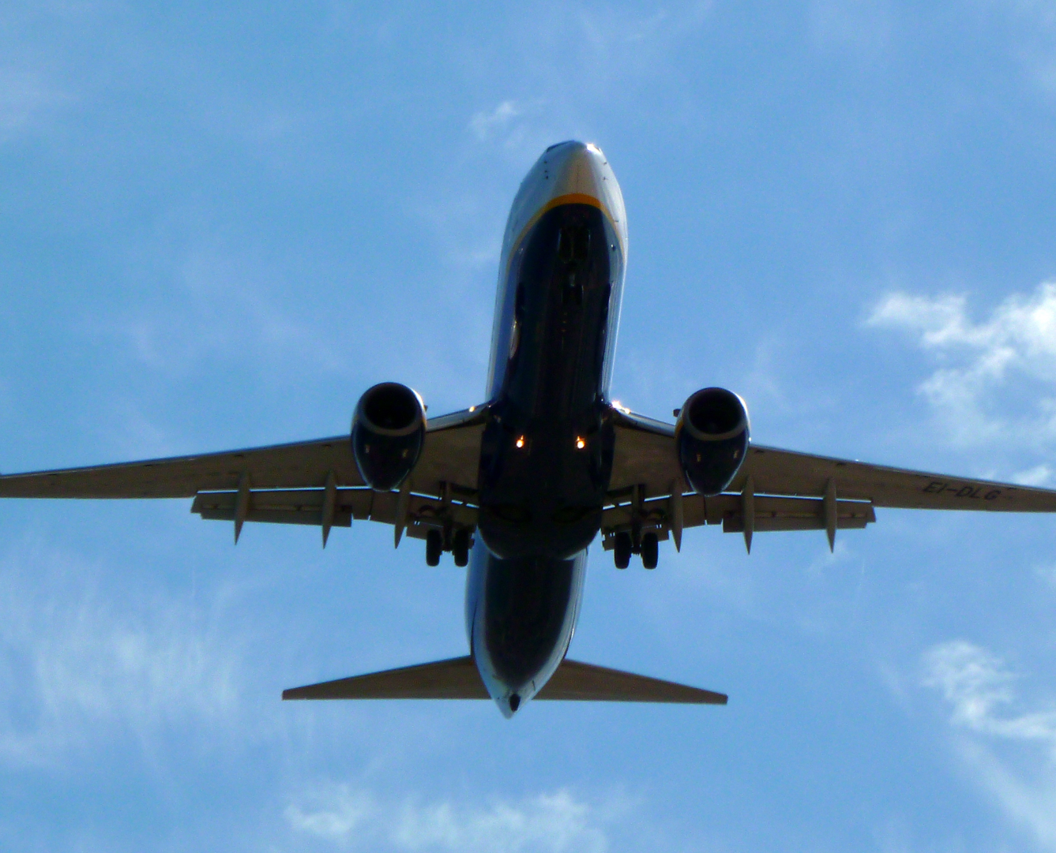

Forecasting empty seats on a monthly basis
Rajamani Chidambaram
Notes:
NOTE:
To change the image on this slide, select the picture and delete it. Then click the Pictures icon in the placeholder to insert your own image.

Slide 2
Problem Statement
Predicting the number of empty seats by month.
This analysis can help with predicting months where seat utilization would be low, so measures can be taken to
Improve the number of reservations by running promotions, deals etc.
Reduce the number of planned flights for the month.

Slide 3
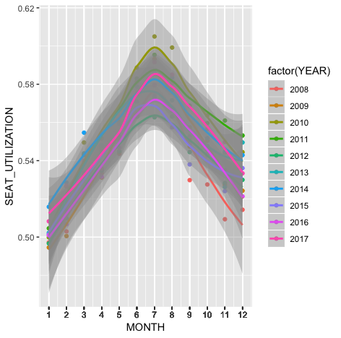
Historical Trends For the Airline Industry
Seat Utilization percentage for the entire industry on average varies for every month and these are the trends shown for different years.
We can observe that maximum seat utilization is during June, July and August in all the years.
January has the least seat utilization in all the years.

Slide 4
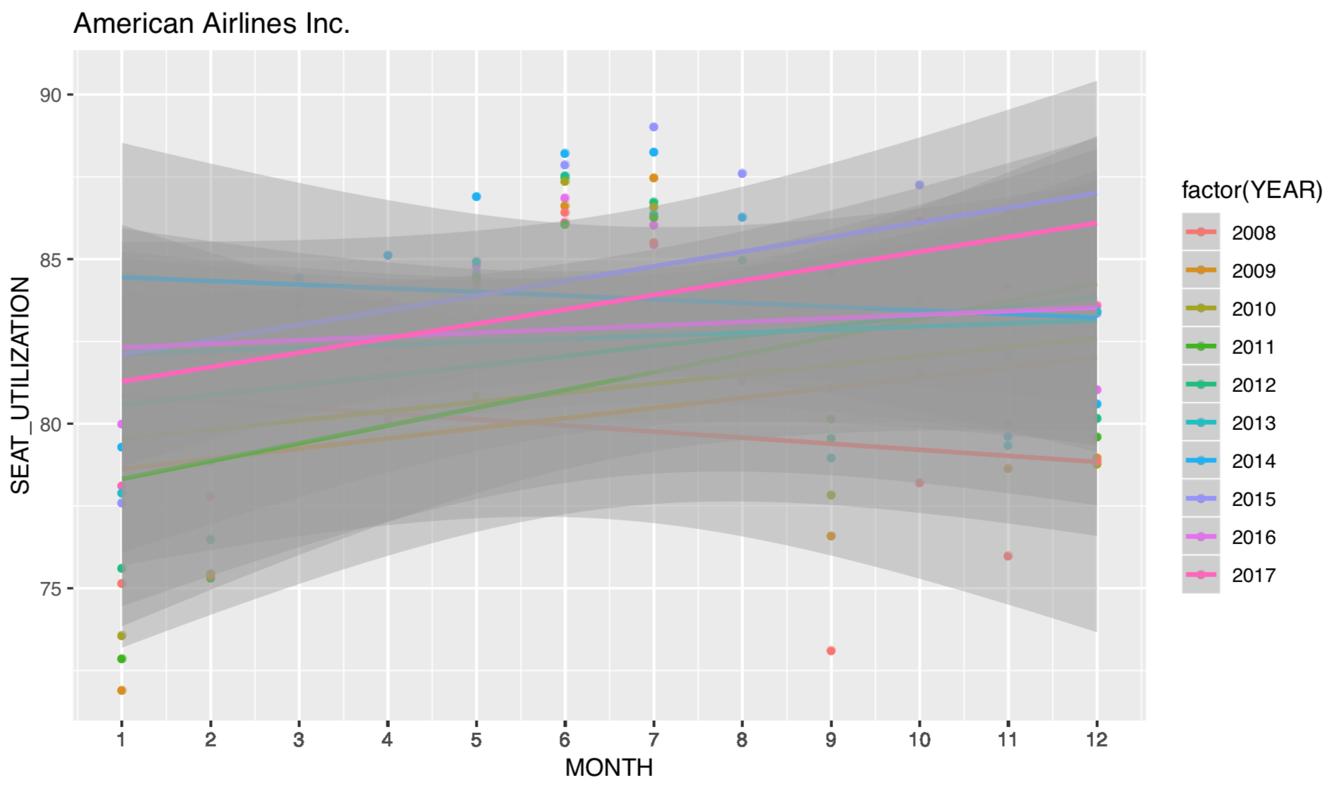
Observed Trends For American Airlines
Seat Utilization monthly trends for American Airlines are similar to the industry in most of the years.
The maximum seat utilization can be expected during June, July and August.
In certain years the seat utilization was much better than usual in the non peak months.

Slide 5
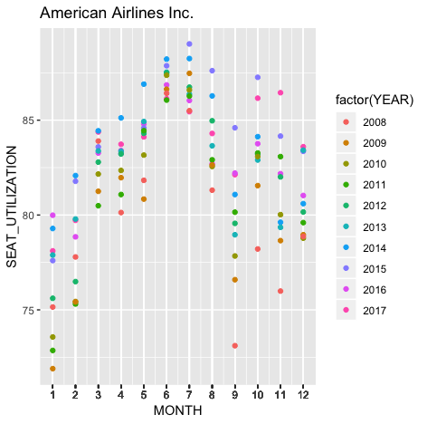
Key Findings
Overall American airlines performs consistently better than the industry average in seat utilization.
July is the peak month that has the maximum seat utilization.
Though January had the lowest seat utilization (around 75%), it was still much better than the industry average (around 50%)
Overall 2014 was a better performing year that had maximum seat utilization in all the months.
2008 and 2009 was the least performing year that had minimum seat utilization.

Slide 6
Future Recommendations
We can compare the different factors such as ticket fares, departure timings, flight routes and number of flights among the best performing and the least performing years.
We can reduce the number of flights in the routes where the seat utilization is consistently low and the industry average is also consistently low.
We can run promotions and deals to improve the seat utilization in certain months or certain routes where the utilization is lower.

Slide 7
Thank you

